Slide 1


Detecting unmet taxi demand
Sponsor
NYC Taxi & Limousine Commision, Analytics Division
Mentors
Dr. Huy Vo, Dr. Kaan Ozbay
Team Members
Bhagwat Singh Bisht, Kiran Venkata Palla, Linfeng Zhou, Sachin Verma, Yuxiang Zhang , Yining Fan

Slide 2
Problem
Unmet demand?
Where to find a taxi at 5 PM in Manhattan? “Go to 59th Street and Second Avenue”¹
No yellow taxis in Outer Boroughs? Thanks to Boro taxis
Study such imbalances in demand and supply across different time periods and locations within NYC
Motivation
Insights for taxi licensing policy
Location recommendations for taxi drivers
1. Here's the real reason why you can't get a New York cab at 5 p.m. http://www.businessinsider.com/worst-time-to-hail-a-cab-in-nyc-2015-11

Slide 3
Objectives
Explore and measure unmet demand for NYC
Identify locations and time periods that show a higher tendency for unmet demand
Understand the unmet demand trends with land use categories
Develop a web-based static visualization tool showcasing the city wise trends

Slide 4
NYC Taxi Industry
Medallion Taxis or Yellow Taxis
Street Hail Liveries (SHLs) or Green Taxis
For-Hire Vehicles or FHVs (Black Cars, Liveries, Luxury Cars)
Commuter Vans
Key facts for 2015
 | Yellow Taxis | Green Taxis | For-hire vehicles
# Vehicles | 13, 587 | 7, 676 | 66, 604
# Drivers | 38, 319 | 13, 455 | 91, 900
Avg. Daily Pick-ups | 400, 294 | 52, 694 | ~50K-100K
Source: 2016 TLC Factbook

Slide 5
Measuring Unmet Demand
Focus on only met demand
Data collection through surveys
GPS technology, taxis across the city act as network of sensors
Commendable efforts by TLC on collecting GPS data
MIT Study¹
Definition & Inference
For a specific location, unmet demand is the ratio of observed demand to excess supply per unit time
A higher unmet demand simply means that there is more demand pressure, and it is harder for a passenger to find an available taxi
1. Inferring Unmet Demand from Taxi Probe Data, Afian Anwar, Amedeo Odoni, Daniela Rus, Massachusetts Institute of Technology, USA

Slide 6

Measuring Unmet Demand
For a specific location and time period,
Excess Demand
Excess Supply
Equilibrium State
How to extract this information from data?

Slide 7
Measuring Unmet Demand
For a specific location and time period,
Taxi Status per unit time
Free
Pick-up (POB)
Busy
Drop-off (POD)
For a single taxi,
Observed demand => Number of times in POB mode
Excess supply => Number of times in Free mode
For all taxis,
Observed demand => Observed demand for taxi1 + Observed demand for taxi2..
Excess supply => Excess supply for taxi1 + Excess supply for taxi2..
Similar approach for location and time period variations

Slide 8
Data Used
Trip records & GPS data (Yellow Taxis, Green Taxis)
NYC MapPluto (~850,000 building blocks) for land use categories
MTA Subway shape files
Fields used
datetime => temporal periods (i.e. weekday/weekend, hourly intervals)
longitude, latitude => location segments (i.e. building block level)
Key facts for 2015
 | Yellow Taxis (TPEP) | Green Taxis (LPEP)
# Records | ~ 3.3 Billion | ~ 600 Million
Time Period | 1 Year (2015) | 1 Year (2015)
File Size | ~ 230 GB | ~ 60 GB

Slide 9


Data Processing Workflow
1
Location
mapping
(i.e. BBL)
Yellow taxi data
Trip Records
(~160 Million Records)
2
4
GPS Data
(~4 Billion Records)
Green taxi data
Borough Shape Files
3
MapPluto
Extraction of Free minutes from GPS data using Trip Records data
SQL Queries
Hadoop
5
Temporal & Spatial Profiles

Slide 10
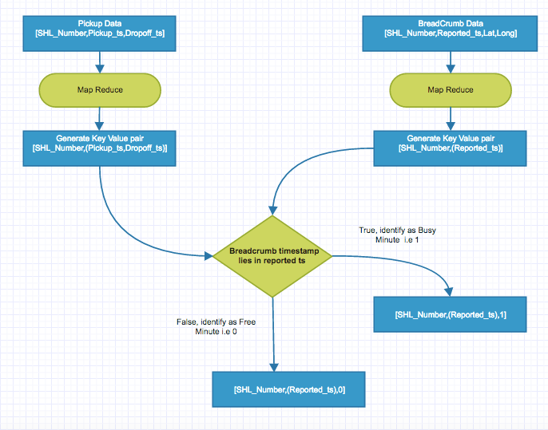
Supply Extraction

Slide 11
Data Processing Challenges
Restricted computing environment
“Impossible” to analyze this data in traditional environment
One day of data would take 1 hour to run
Later shifted to big data cluster environment
Big data processing
Spatial mapping of location attributes to BBL
Merging of trip records and GPS data
Few processing queries took up to 8 hours

Slide 12
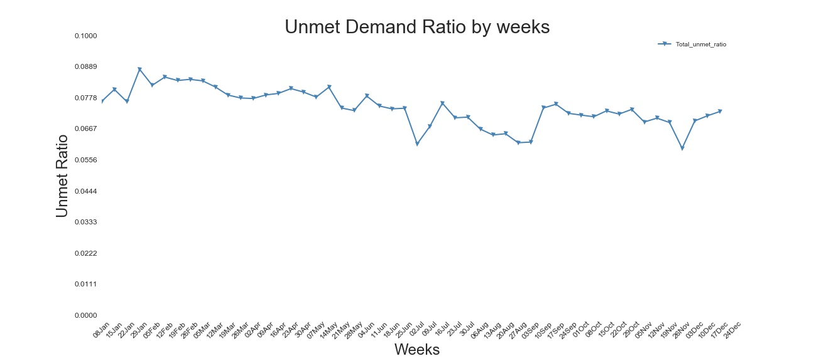
Temporal profiles

Slide 13
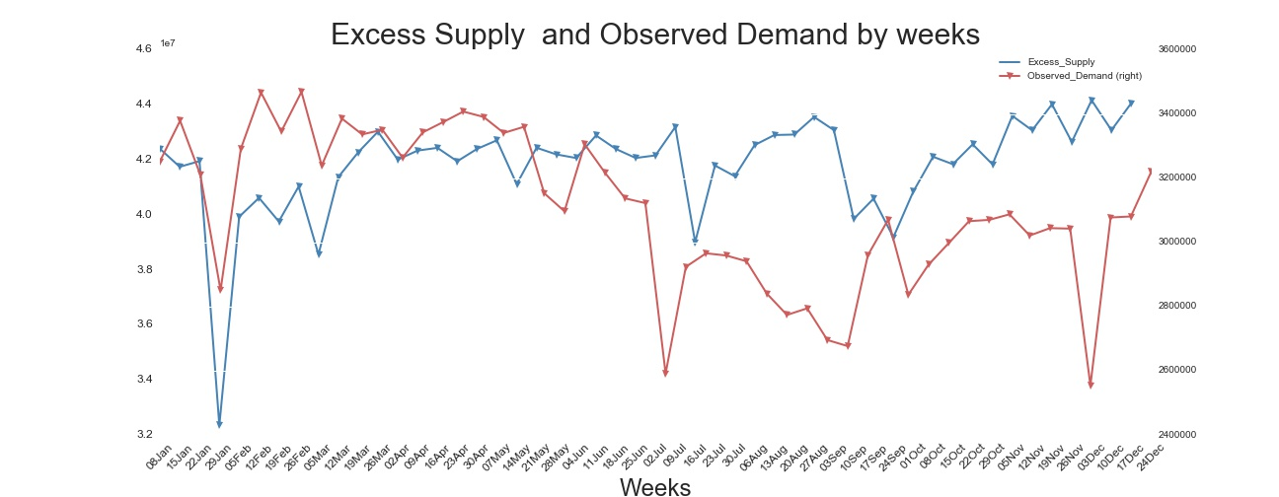
Temporal profiles
Observed Demand
Excess Supply
July 4th
Thanks Giving

Slide 14
Spatial profiles
Grouping ~850,000 BBL’s using overall unmet demands
Segment | Description
Top 33 P | Falling within top 33%
Middle 33 P | Falling within middle 33%
Bottom 33 P | Falling within bottom 33%
No Supply | No supply but demand exists
No Demand | No demand but supply exists
No Coverage | No demand and supply

Slide 15
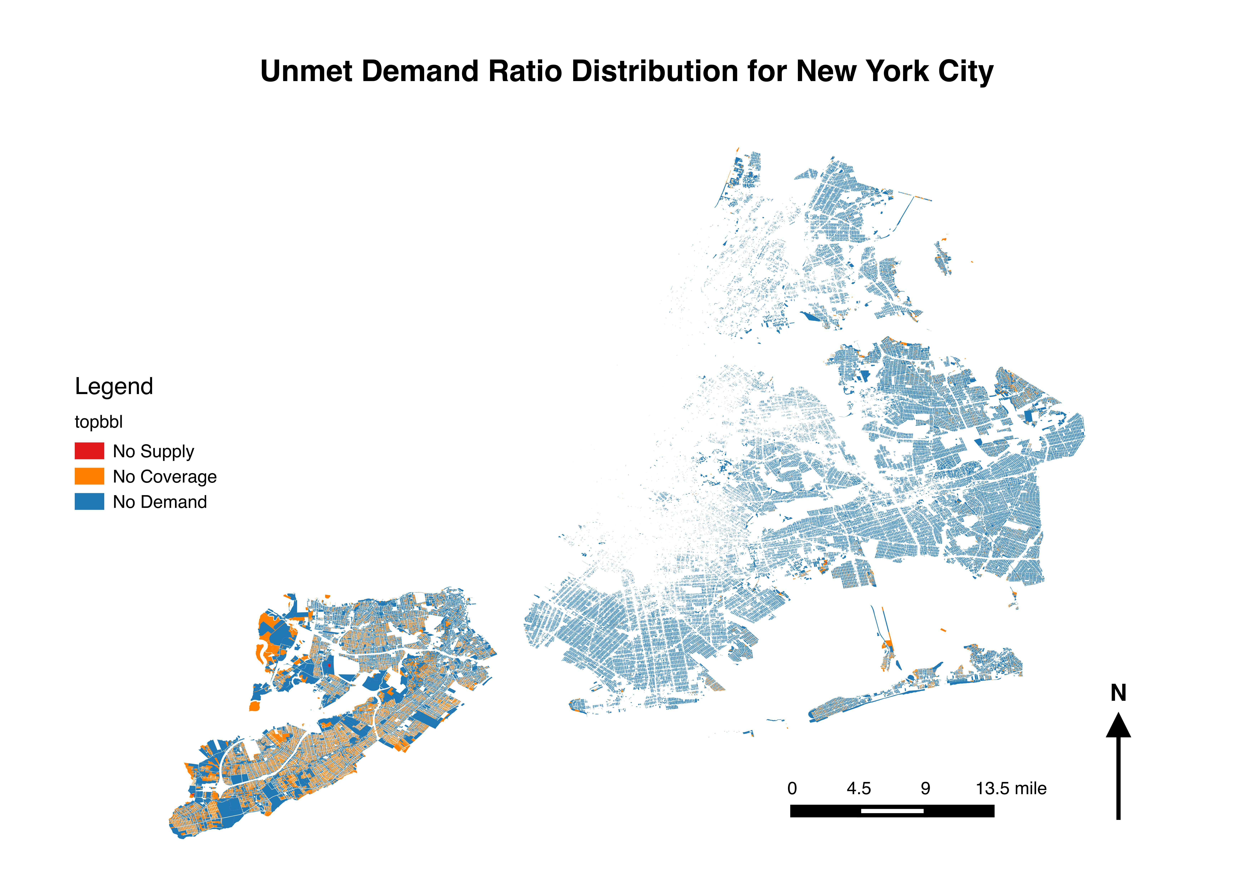
Spatial profiles
Manhattan

Slide 16
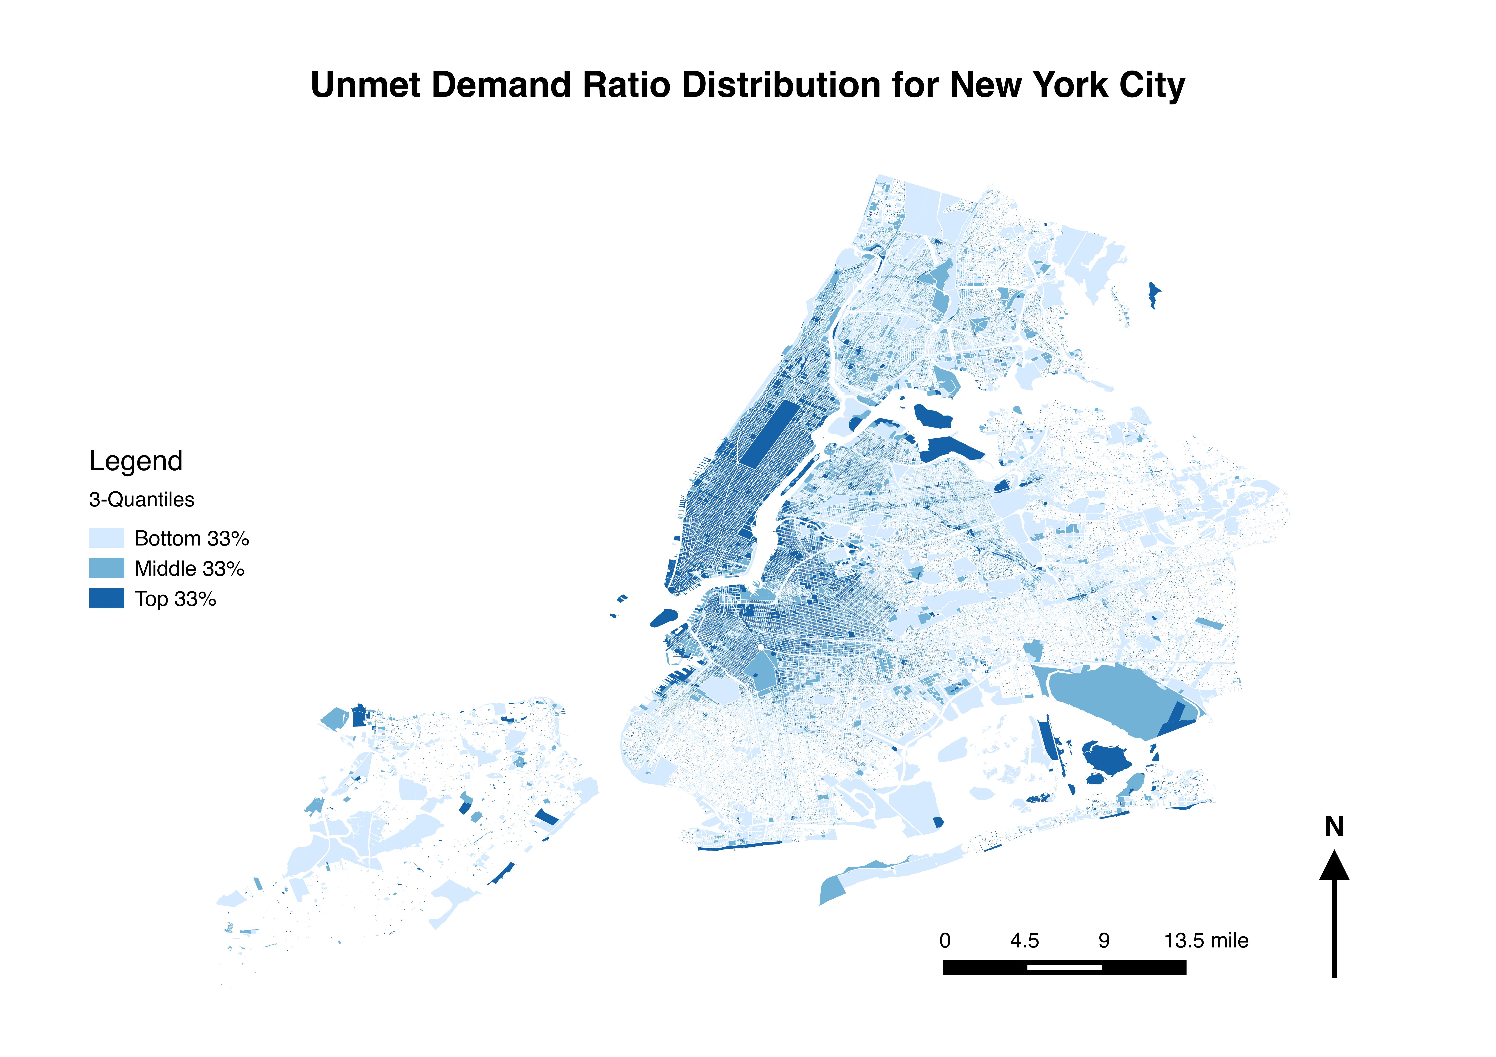
Spatial profiles
Top 33P
Middle 33P
Bottom 33P

Slide 17
Spatial profiles
Criterion
Filtered from Top 1% of observed demand
Yankee Stadium
Williamsburg

Slide 18
Spatial profiles
Fieldston
Laguardia
Airport

Slide 19
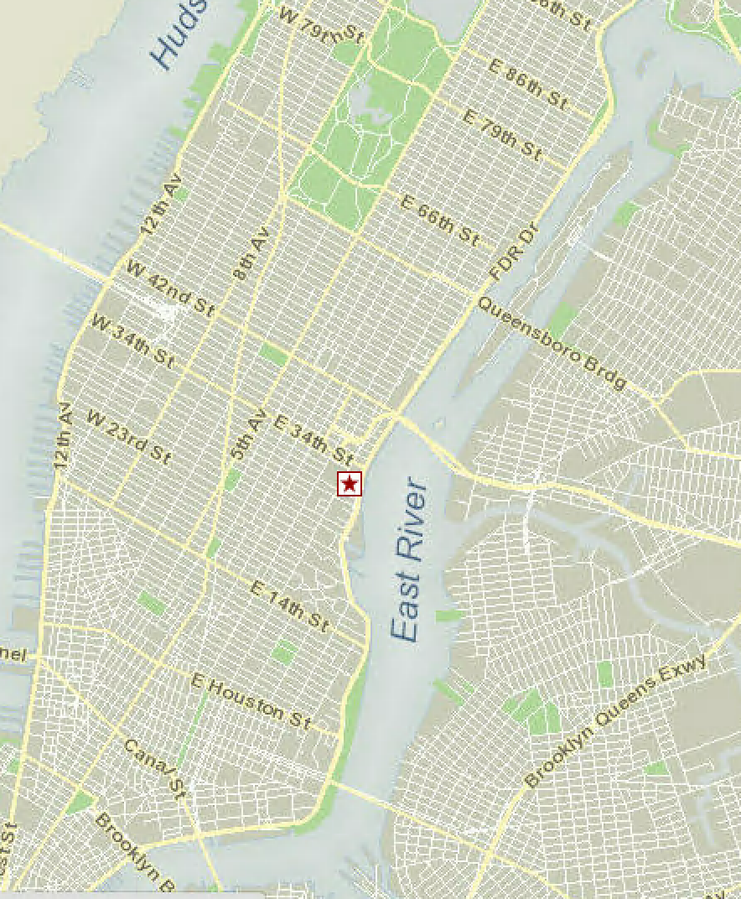
BBL profiles
Weekend
Weekday

Slide 20
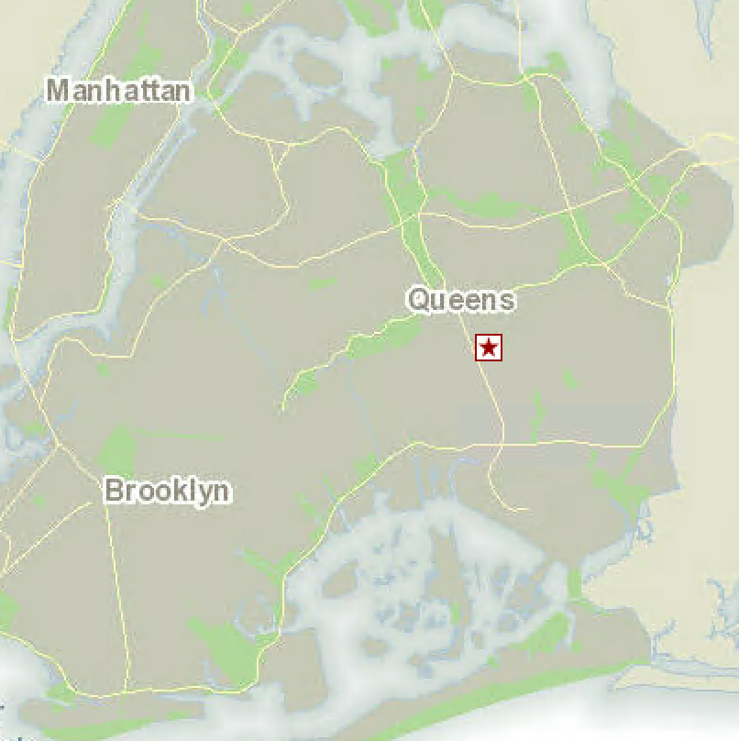
BBL profiles
Weekend
Weekday

Slide 21
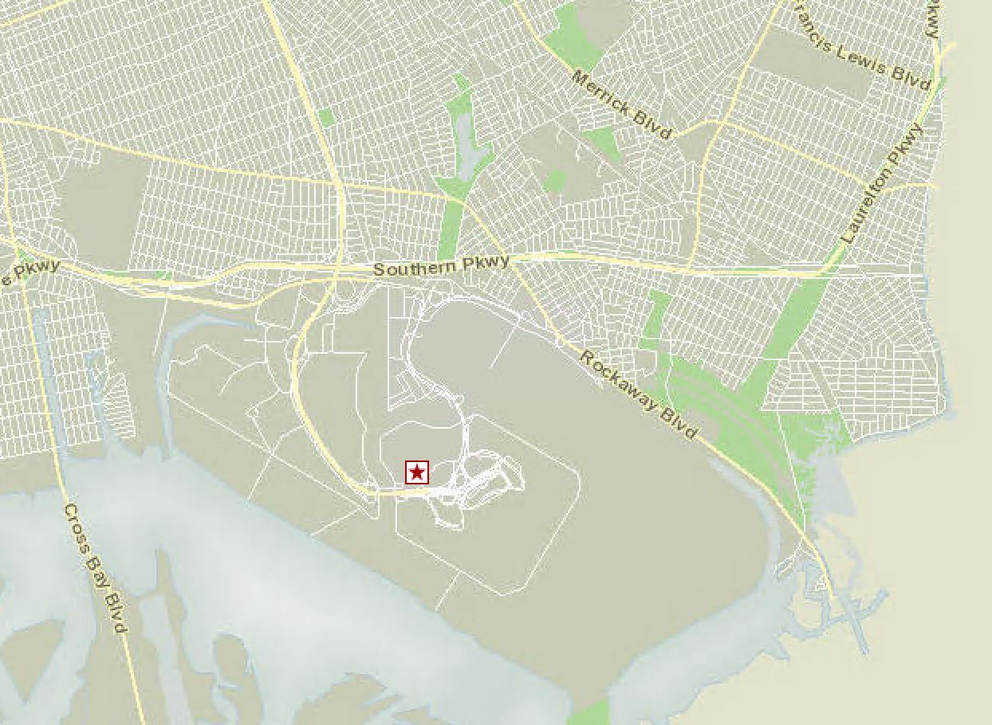
BBL profiles
Weekend
Weekday

Slide 22
Land Use Profiles

Slide 23
Limtations
Each taxi shares its information only once within the minute interval
Each taxi is serving only one passenger at a given time and location
Inaccuracies in location mapping for BBL
Even including taxi waiting times for analysis

Slide 24
Conclusions & Next Steps
Conclusions
Possible to measure unmet demand using GPS data
Influence of land use categories on unmet demand is observed
Higher unmet demands in locations closer to subway stations
Next steps
Include additional demand data i.e. FHV, E-Hail
Exclude the busy routes for the computation of excess supply
Optimization of data processing algorithms

Slide 25
Summary
Objective
Define, measure and understand unmet demand
Study variations across locations and time periods
Data & Methodology
Big data with file sizes of ~300 GB and more than ~3 Billion records
Metric defined as ratio of observed demand and excess supply
Outcomes
Staten island has least taxi exposure, while Manhattan is fully covered
Identified few locations with higher unmet demands across boroughs
Higher influence of these locations along subway lines indicating last mile solution

Slide 26
Visualization Tool Demo
Web based visualization tool built with simple features showcasing land use categories, average hourly trends for weekday and weekend

Slide 27
Thank You!!

